Slide 1
FHIR for Executives 2 of 2
Lloyd McKenzie
June 21, 2016

Slide 2
This presentation
Can be downloaded here:
http://gforge.hl7.org/svn/fhir/trunk/presentations/2016-06%20Webinars/FHIR%20for%20Executives2.pptx
Use “anonymous” and email address to logon
Is licensed for use under the Creative Commons, specifically:
Creative Commons Attribution 3.0 Unported License
(Do with it as you wish, so long as you give credit)

Slide 3
Outline
Before break
After break
Why FHIR?
What makes FHIR different?
Core principles
Power of an interface
FHIR Resources
How does FHIR Compare?
FHIR Status
Where is FHIR being used?
Risks & Next steps
Notes:
Toggle

Slide 4
Outline
Monday
Tuesday
Why FHIR?
What makes FHIR different?
Core principles
Power of an interface
FHIR Resources
How does FHIR Compare?
FHIR Status
Where is FHIR being used?
Risks & Next steps
Notes:
Toggle

Slide 5
How does FHIR compare?

Slide 6
V2 and FHIR
Similarities
FHIR Differences
Built around re-usable “chunks” of data
Strong forward/backward compatibility rules
Extensibility mechanism
Each chunk (resource) is independently addressable
More than messages
Human readable required
Extensions don’t collide, are discoverable
Modern tools/skills
Instances easy to read
Lighter spec
Notes:
Many interface engine vendors working on FHIR support
May make sense for internals of some v2 systems
Add-on interface for mobile, personal health record

Slide 7
V3 and FHIR
Similarities
FHIR Differences
Based on RIM, vocab & ISO Data types foundations
Support XML syntax
Simpler models & syntax (reference model hidden)
Friendly names
Extensibility with discovery
Easy inter-version wire compatibility
Messages, documents, etc. use same syntax
JSON syntax too
Notes:
Lower learning curve
Unlikely to see significant new v3 initiatives in areas that aren’t already committed to it

Slide 8
FHIR and CDA
Similarities
FHIR Differences
Support profiling for specific use-cases
Human readability is minimum for interoperability
APIs, validation tooling, profile tooling
(See v3 similarities on prior slide)
Initial discrete interoperability with the base specification (no templates)
Not restricted to just documents
Implementer tooling generated with spec
(See v3 differences on prior slide)
Notes:
Significant work on CCDA <-> FHIR
Can use both FHIR and CCDA documents with XDS and with MHD

Slide 9
FHIR and Services
Similarities
FHIR differences
Encourage context neutral, re-usable structures with defined behavior
RESTful interface is a simple SOA interface
Consistent data structures across services
Ease of transport across paradigms message <-> service <-> document <-> REST
Standard framework for defining/discovering services
Notes:
FHIR allows defining simple services via the “OperationDefinition” mechanism as well as custom services.
E.g. Value set expansion, code translations – full terminology services

Slide 10
So why use anything else?
FHIR is brand new
Minimal market share
Not yet normative
Limited track record
Business case
No-one dumps existing working systems just because something new is “better”
Most Large projects committed to one standard won’t change direction quickly (or even at all)

Slide 11
FHIR as a replacement
Yes, FHIR has the potential to supplant HL7 v3, CDA and even v2
However
It’s probably not going to do so right away
HL7 will support existing product lines so long as the market needs them
Notes:
Few will throw away their investment in older standards to use FHIR until
The specification has a good track record
It’s clear the new thing provides significant benefits

Slide 12
Status of FHIR

Slide 13
FHIR Timeline (planned)
First Draft
1st
STU
~ 2nd
STU
~ 3rd
STU
~ 1st
Norm?
. . .
2011
2012
2013
2014
2015
2016
2017
2018
2019
2020
Notes:
Note that dates are subject to change based on resources and the standards process

Slide 14
STU 2
Published Sept 2015
Expected 3.0 content includes:
Migration of multiple resources from draft to STU
Revamp of some resources to reflect workflow
Improved quality of resources – migration up the maturity level

Slide 15
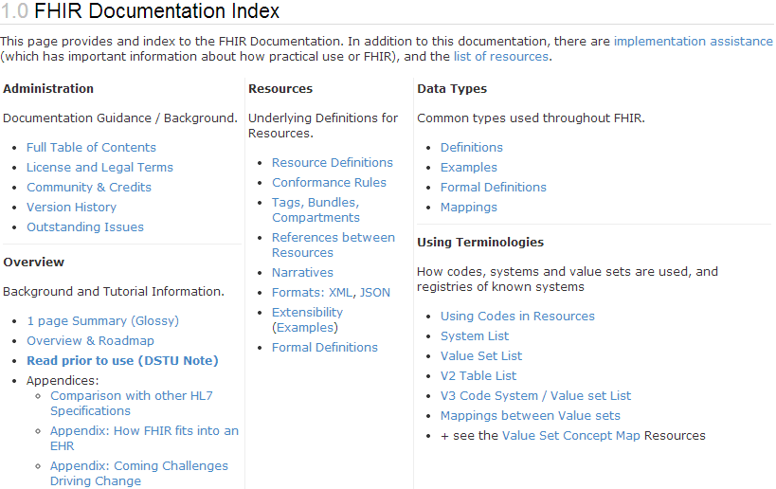
What does STU mean?
“…all aspects of the FHIR specification are potentially subject to change
Notes:
Split resources, dropped resources, changed JSON and XML syntax, added and changed elements, renamed data types

Slide 16
Maturity levels
Intended to indicate level of stability
FMM1 – Resource is “done”, no build warnings
FMM2 – Tested at approved Connectathon
FMM3 – Passes QA, has passed ballot
FMM4* – Tested across scope, published, prototype implementation
FMM5* – 5 distinct production implementations, multiple countries, 2
Non-compatible changes at level 4 and 5 will face increased hurdles

Slide 17
Normative FHIR
Will include
Core specification
Structural resources
Subset of other resources
Some resources won’t go normative right away
Future releases
Add more resources
Add profiles on existing resources
May add elements to resources
Very rare

Slide 18
Using FHIR

Slide 19

Where can FHIR be used?
Classic in-institution interoperability
Back-end e-business systems (e.g. financial)
Regional Health Information Organizations (RHIO)
National EHR systems
Social Web (Health)
Mobile Applications
Near
Term

Slide 20
Implementation during STU
FHIR is new
No commitment yet to backward compatibility
No stability guarantee until 2018+
Some resources didn’t exist in initial version
Appointment, Referral, Insurance, Nutrition, etc.
However, implementers are choose to build with it anyhow and have continued to do so

Slide 21
Who’s working with FHIR?
>200 organizations declared
attended a Connectathon and/or
signed up on wiki
Aware of many others not on either list
Almost 300 participants on the FHIR Implementer’s Skype chat
Probably scared away another 50%
Now http://chat.fhir.org
20+ countries involved so far

Slide 22
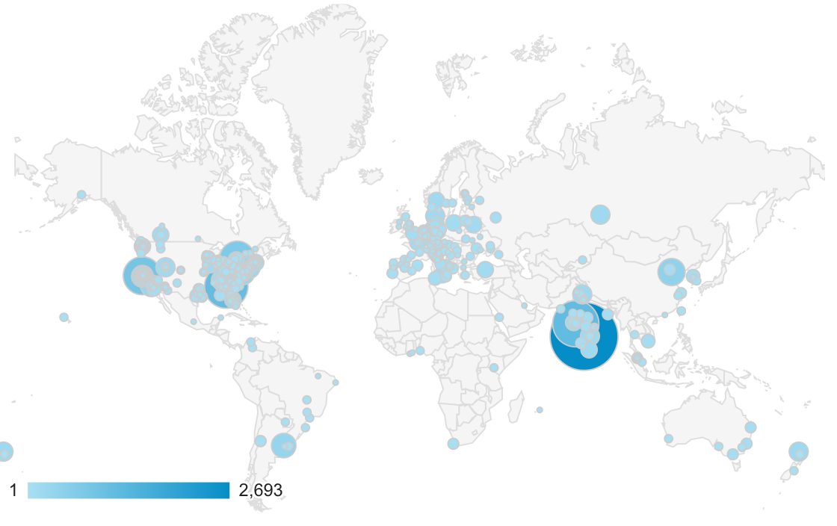
Who’s using FHIR?
Systems accessing HAPI server in 2015
Notes:
Jan->mid Nov. 2015 – unique systems accessing the HAPI test server

Slide 23

FHIR & other SDOs
IHE
Using FHIR for MHD (mobile XDS)
FHIR profile for PIX/PDQ, CMAP, RECON, Accountable Order
DICOM
Building profile to make key images available to EHR
W3C
Semantic health group helping us with RDF, RIM-based semantic checking
Notes:
Because FHIR is free and because of how it’s structured, use by other SDOs is certainly possible CMAP = Clinical Mapping; RECON = reconciliation, Assessment of orders for accountable use criteria in guidelines

Slide 24
Governments
US – ONC
Sponsoring 3 projects, including mapping meaningful use to FHIR
UK
One implementation live, lots more in the pipeline
Lithuania
Chose FHIR as the basis for their national EHR

Slide 25
EHR Vendors
Many significant EHR vendors have made commitments to FHIR implementation
AllScripts, Cerner, Epic, McKesson, Meditech
Voluntarily investing in accelerating the standard
E.g. Argonaut, participating in standards development

Slide 26
Other support
Large and small healthcare organizations
E.g. Mayo, Intermountain Healthcare, University Health Network
Small vendors, start-ups
Lots and lots – all over the world

Slide 27
FHIR & CDA
HL7 developing FHIR profiles for CCDA
Will have key ones present in next STU
HL7 project to define “Clinical Document Architecture” in FHIR
At least 3 projects looking at providing automated transformation between CCDA and FHIR

Slide 28
HSPC
Health Services Platform Consortium
Intermountain Healthcare, Veterans Affairs, Harris, Telus, Dignity Health, IBM, Epic, Cerner, Mayo, HP, Kaiser, +++ (not all are official members)
Leverage FHIR + security and additional layers to allow plug & play EHR modules
Stems from SMART on FHIR work

Slide 29
Case study 1
Who
Oridashi – Australian eHealth consultant/vendor
What
Use FHIR as primary care EMR integration interface to two leading primary care CISs.
Enables decision support, referral and personal health record portals.
When
Full production Fall, 2014

Slide 30
Case Study 2
Who
Healthcentrix.co – U.S. cloud-based PHR start-up
What
Community portal, PHR, mobile health assistant, device aggregator
XDS persistence integrated with a CCDA bridge (HISP Direct and HIE)
Patients, doctors and families share PHI, care plans & patient-generated data
When:
Alpha Feb (200 patients). Beta May, Prod: July

Slide 31
Case Study 3
Who
Choice-Hospital-Systems & Health Samurai (USA)
What:
CCHIT certified cloud-based EHR system
Open source FHIR server implementation
When
Available Fall 2014. Enhancing to support LOINC, SNOMED and advanced search and plug-ins for CDA, v2

Slide 32
Case Study 4
Who
Health & Social Care Information Centre (England)
What
National risk registry (profiling using Forge).
RESTful API for primary care. Initial focus on demographics + appointments, then health summaries, vaccinations, meds
When
Risk registry by mid-summer, API “in progress”

Slide 33
Case Study 5
Who
Intermountain Healthcare – provider org (USA)
What
Converting 3000+ detailed clinical models and their accompanying value sets to FHIR
Plan to use them with HSPCS
When
Complete public review within next 6 months

Slide 34
Case study 6
Who
Orion Health - vendor (New Zealand)
What
Updates to Integration engine to map v2 to FHIR
Read APIs for all CDR models
iOS Application to expose HealthKit data over FHIR to cloud based repository for viewing by patient and authorized providers
When
Engine – Q2 2015, APIs Q3, iOS Q4

Slide 35
Case Study 7
Who
University Health Network (Canada)
What
Replace existing custom SOAP interface to back-end systems (CDR, EMPI, HIS, etc.)
When
Production:
Registration/ADT, Clinical Document and Med order clinical portal portion production (2014)
Electronic discharge & medication summary
Notes:
Have also updated their HAPI v2 integration engine to support FHIR

Slide 36
Case Study 8
Who
UNICEF, USAID, IntraHealth, OpenMRS, +++
What
Sharing Practitioner, Location & Organization registry information over IHE’s CSD to SMS applications for front-line Ebola healthcare workers
When
Prod: Liberia in Aug.; Sierra Leonne, Guinea fall
Rollout & expansion in several more countries over subsequent months

Slide 37
Case study takeaways
Broad international interest
Wide range of engagement
National initiatives
Care provider organizations
Small vendors/entrepreneurs
Mixture of green-field and upgrading existing systems
All with short times to production
Baby steps to full commitment

Slide 38
FHIR Risks
And mitigations

Slide 39
Risks with FHIR
FHIR is new
Be ready to migrate
Caution for mission critical applications
FHIR is cool
Be realistic about what’s achievable
Work with others (HL7, IHE, etc.) to build profiles
FHIR is coming
At minimum, monitor
Consider whether to pilot to build experience
Notes:
Still in STU
No backward compatibility guarantee
Some content missing
Limited production experience
Change is likely
Near the top of the hype curve
FHIR won’t fix all interoperability issues
Consensus, terminology, legacy burdens still exist
FHIR provides a framework and platform
Hard work still in profiling
Mitigations
Be realistic about what’s achievable
Work with others (HL7, IHE, industry groups) on the profiles you’ll need
Momentum is high – it will disrupt the health IT environment
Strong interest from regulators (e.g. ONC)
Strong interest from major vendors
Hitting at all points in the market chain
Plan what you could do, decide conditions for entry

Slide 40
Next Steps
For you and your organization

Slide 41

Next Steps
Is this something your organization wants/needs to track?
Monitor
Have someone sign up to the FHIR list or Zulip chats
(instructions on the wiki)
http://wiki.hl7.org?title=FHIR
Engage
Have someone read through the specs
Send someone to development tutorials
Have your organization participate in or observe a connectathon
Participate in the upcoming STU ballot

Slide 42
Education opportunities
Attend a Working Group Meeting
Tutorials, Connectathons
Sept 17-23 Baltimore
Jan 13-20 San Antonio
Attend an Implementation Workshop
Intensive tutorials, hands-on
Likely November
Quality Measures on FHIR – July 11-12, Chicago
FHIR Institute Webinars
Oct 24-28
Dec 5-9
Custom education available

Slide 43

Other events
July 27-28 – Harvard Medical School
http://bit.ly/FHIRAPP

Slide 44





International HL7 FHIR Developer Days November 16-18, 2016 in Amsterdam
Education
12 speakers
16 tutorials/presentations
18 tracks
Connectathon
Meet fellow developers
Put FHIR to the test
Networking
FHIR experts and authors on hand
http://fhir.furore.com/devdays

Slide 45
Final message
FHIR
is easier and cheaper
is being implemented now
is likely to significantly impact Health IT
Decide how you want it to impact your organization

Slide 46

Questions?
http://hl7.org/fhir lmckenzie@gevityinc.com

